Slide 1
Xamarin Introduction
Xamarin is a software company that offers a suite of commercial Mono-based products that allow developers to create apps for Android, iOS, and OS X using C# and the .NET framework.
Xamarin's primary product offerings are:
Xamarin Platform
Xamarin.Android (formerly Mono for Android)
Xamarin.iOS (formerly MonoTouch)
Xamarin.Mac
Xamarin Test Cloud: Allows developers to write automated test scripts and upload them to Xamarin Test Cloud. Here the automated test scripts are run across a range of devices and the test results/reports are shared.
Xamarin Insights : Add real-time monitoring with precise, detailed error reporting to your apps in a single line of code

Slide 2
Xamarin Licensing
Each of these products is licensed through an annual subscription with the following levels being available:
Starter: This subscription is actually free, but restricts the size of apps.
Indie: This subscription provides everything needed to build and deploy full-featured mobile apps, but can only be purchased by companies with five or less employees. This subscription also does not include the use of the Visual Studio add-in discussed in the Using the Visual Studio environment section.
Business: This subscription adds the use of the Visual Studio add-in as well as e-mail support.
Enterprise: This subscription adds access to a set of prime components, hotfixes, and enhanced support

Slide 3
Xamarin Studio
Xamarin Studio is a customized version of the MonoDevelop IDE and this can be used to develop applications for Android, iOS, and OS X. Xamarin Studio is available on both OS X and Windows with highly advanced and useful features such as:
Code completion
Smart syntax highlighting
Code navigation
Code tooltips
Integrated debugging for mobile apps running in emulators or on devices
Source control integration with Git and Subversion built-in
Provides access to Xamarin component store
Provides integration to Nuget packages
Xamarin Studio designer support for Android(axml) and IOS (storyboards) is excellent

Slide 4
Xamarin Studio installation
Setting up a xamarin account
Go to https://xamarin.com/account/register
Provide the details
Account is tied to the email. So you cannot re-use the same email over and over.
Installation:
Studio IDE is free to download
Go to https://xamarin.com/download
Download the correct installer (OSX / Windows)
Run the installer and follow the instructions.
Starting a trial version: Trial version gives a 30 day fully functional business edition with a 24 hour lifetime for the built apps.
Open Xamarin Studio.
Click Tools >> Account. Enter your xamarin account creds and login
On the IDE welcome page click “Start Trial”

Slide 5
Advantages of using Xamarin Platform
Xamarin platform allows developers to create native iOS, Android, Mac and Windows apps in C#
Advantages
One language, multiple platforms (iOS, Android and Windows)
Native look and feel and performance
Shared business logic
UI can also be shared using Xamarin Forms
Fewer bugs because of shared paradigm
Faster time to market

Slide 6
Mono framework & Xamarin
Xamarin installs Mono framework when installing the Xamarin Studio IDE .
Mono, the open source development platform based on the .NET framework, allows developers to build cross-platform applications with improved developer productivity.
Sponsored previously by Novell and now by Xamarin, the Mono project has an active and enthusiastic contributing community
Mono platform components:
C# Compiler - Mono’s C# compiler is feature complete for C# 1.0, 2.0, 3.0, 4.0 and 5.0 (ECMA). A good description of the feature of the various versions is available on Wikipedia.
Mono Runtime - The runtime implements the ECMA Common Language Infrastructure (CLI). The runtime provides a Just-in-Time (JIT) compiler, an Ahead-of-Time compiler (AOT), a library loader, the garbage collector, a threading system and interoperability functionality.
Base Class Library - The Mono platform provides a comprehensive set of classes that provide a solid foundation to build applications on. These classes are compatible with Microsoft’s .Net Framework classes.
Mono Class Library - Mono also provides many classes that go above and beyond the Base Class Library provided by Microsoft. These provide additional functionality that are useful, especially in building Linux applications.

Slide 7
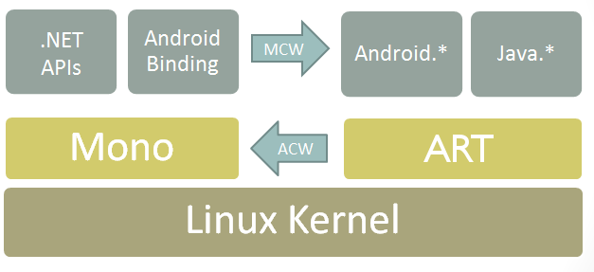
Xamarin iOS has mtouch command line tool that compiles/converts the C# code to ARM executable binary. This binary is then deployed to the device.
Xamarin Android works in a slightly different way. Since Android allows other runtimes, a Xamarin android application is installed with a Mono for Android runtime. The managed .net code talks to Mono runtime.

